Slide 1
Machine Learning
Principal Component Analysis

Slide 2
Principal Component Analysis (PCA)
It is a popular technique used to:
Reduce number of dimensions in data
Find patterns in high-dimensional data
Visualize data of high dimensionality
It is a linear transformation that chooses a new coordinate system for the data set such that
greatest variance by any projection of the data set comes to lie on the first axis (called the first principal component),
the second greatest variance on the second axis, and so on.
PCA can be used for reducing dimensionality by eliminating the later principal components
PCA produces a low-dimensional representation of a dataset. It finds a sequence of linear combinations of the variables that have maximal variance, and are mutually uncorrelated.
Example applications:
Face recognition
Image compression
Gene expression analysis
Apart from producing derived variables for use in supervised learning models like regression, PCA also serves as a tool for data visualization.

Slide 3
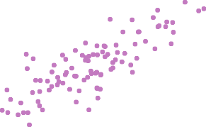
Ad Spending
0 5 10 15 20 25 30 35
10
20
30 40 50
60
70
Population
The population size (pop) and ad spending (ad) for 100 different cities are shown as purple circles. The green solid line indicates the first principal component, and the blue dashed line indicates the second principal component.

Slide 4
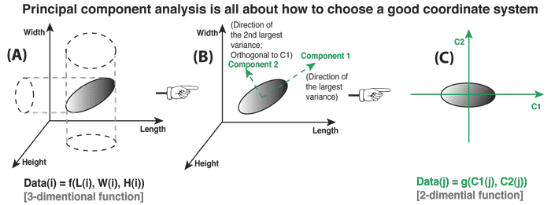

Slide 5
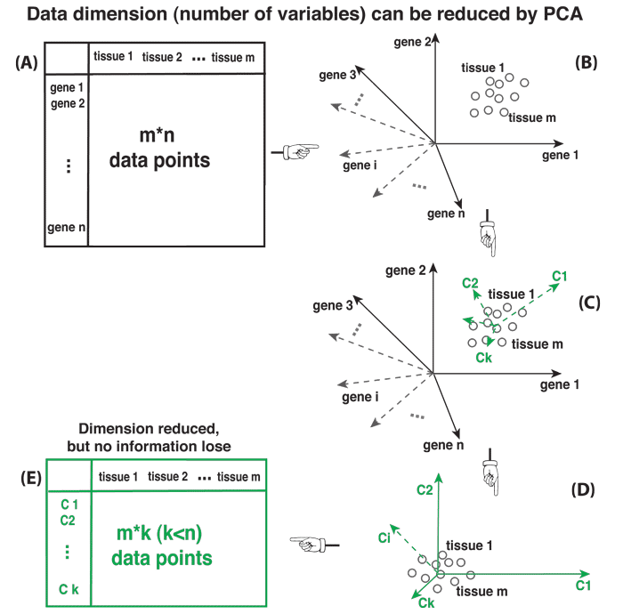
Find the mean value of all data, and set it as the coordinate origin;
Find the direction along which the data set has the largest variance. We call it "component 1".
Find another direction that is orthogonal to all components already found, and along which the data has the largest possible variance. We call this direction "component 2".
repeat step 3 until we get K principal components and no more component can be found. (step 1~4, see Figure C)
Re-plot the data set under the new coordinate system defined by K principal components (see Figure D).

Slide 6
PCA process (a simple Example) STEP 1
Subtract the mean
from each of the data dimensions. All the x values have x subtracted and y values have y subtracted from them. This produces a data set whose mean is zero.
Subtracting the mean makes variance and covariance calculation easier by simplifying their equations. The variance and co-variance values are not affected by the mean value.

Slide 7
PCA process –STEP 1
DATA:
x y
2.5 2.4
0.5 0.7
2.2 2.9
1.9 2.2
3.1 3.0
2.3 2.7
2 1.6
1 1.1
1.5 1.6
1.1 0.9
ZERO MEAN DATA:
x y
.69 .49
-1.31 -1.21
.39 .99
.09 .29
1.29 1.09
.49 .79
.19 -.31
-.81 -.81
-.31 -.31
-.71 -1.01

Slide 8
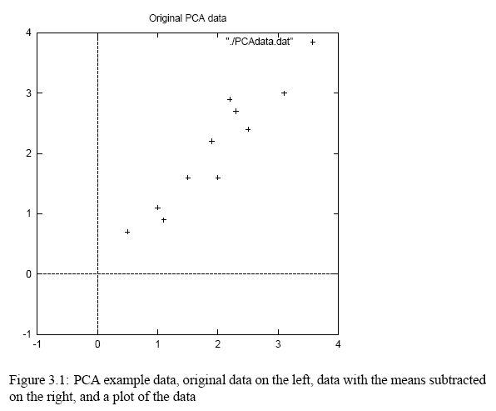
PCA process –STEP 1

Slide 9
PCA process –STEP 2
Calculate the covariance matrix
cov = .616555556 .615444444
.615444444 .716555556
since the non-diagonal elements in this covariance matrix are positive, we should expect that both the x and y variable increase together.
Covariance matrix
Representing Covariance between dimensions as a matrix e.g. for 3 dimensions:
cov(x,x) cov(x,y) cov(x,z)
C = cov(y,x) cov(y,y) cov(y,z)
cov(z,x) cov(z,y) cov(z,z)
Diagonal is the variances of x, y and z
cov(x,y) = cov(y,x) hence matrix is symmetrical about the diagonal
N-dimensional data will result in nxn covariance matrix

Slide 10
PCA process –STEP 3
Calculate the eigenvectors and eigenvalues of the covariance matrix
eigenvalues = .0490833989
1.28402771
eigenvectors = -.735178656 -.677873399
.677873399 -.735178656

Slide 11
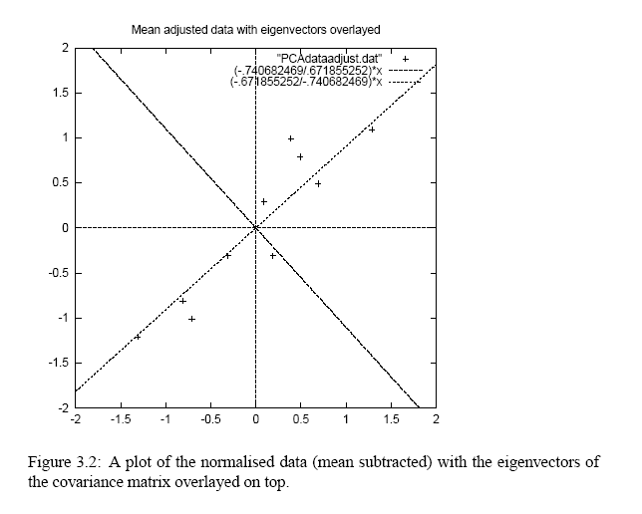
PCA process –STEP 3
eigenvectors are plotted as diagonal dotted lines on the plot.
Note they are perpendicular to each other.
Note one of the eigenvectors goes through the middle of the points, like drawing a line of best fit.
The second eigenvector gives us the other, less important, pattern in the data, that all the points follow the main line, but are off to the side of the main line by some amount.

Slide 12
PCA process – STEP 4
Reduce dimensionality and form feature vector
The eigenvector with the highest eigenvalue is the principle component of the data set.
In our example, the eigenvector with the largest eigenvalue was the one that pointed down the middle of the data.
Once eigenvectors are found from the covariance matrix, the next step is to order them by eigenvalue, highest to lowest. This gives you the components in order of significance.
Now, if you like, you can decide to ignore the components of lesser significance
You do lose some information, but if the eigenvalues are small, you don’t lose much
n dimensions in your data
calculate n eigenvectors and eigenvalues
choose only the first p eigenvectors
final data set has only p dimensions.

Slide 13
PCA process –STEP 4
Feature Vector
FeatureVector = (eig1 eig2 eig3 … eign)
We can either form a feature vector with both of the eigenvectors:
-.677873399 -.735178656
-.735178656 .677873399
or, we can choose to leave out the smaller, less significant component and only have a single column:
- .677873399
- .735178656

Slide 14
PCA process –STEP 5
Deriving the new data
FinalData = RowFeatureVector x RowZeroMeanData
RowFeatureVector is the matrix with the eigenvectors in the columns transposed so that the eigenvectors are now in the rows, with the most significant eigenvector at the top
RowZeroMeanData is the mean-adjusted data transposed, i.e. the data items are in each column, with each row holding a separate dimension.

Slide 15
PCA process – STEP 5
FinalData is the final data set, with data items in columns, and dimensions along rows.
What will this give us?
It will give us the original data solely in terms of the vectors we chose.
We have changed our data from being in terms of the axes x and y , and now they are in terms of our 2 eigenvectors.
Basically we have transformed our data so that it is expressed in terms of the patterns between them, where the patterns are the lines that most closely describe the relationships between the data. This is helpful because we have now classified our data point as a combination of the contributions from each of those lines.

Slide 16
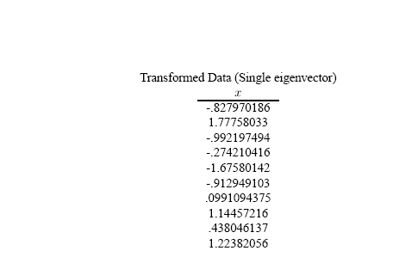
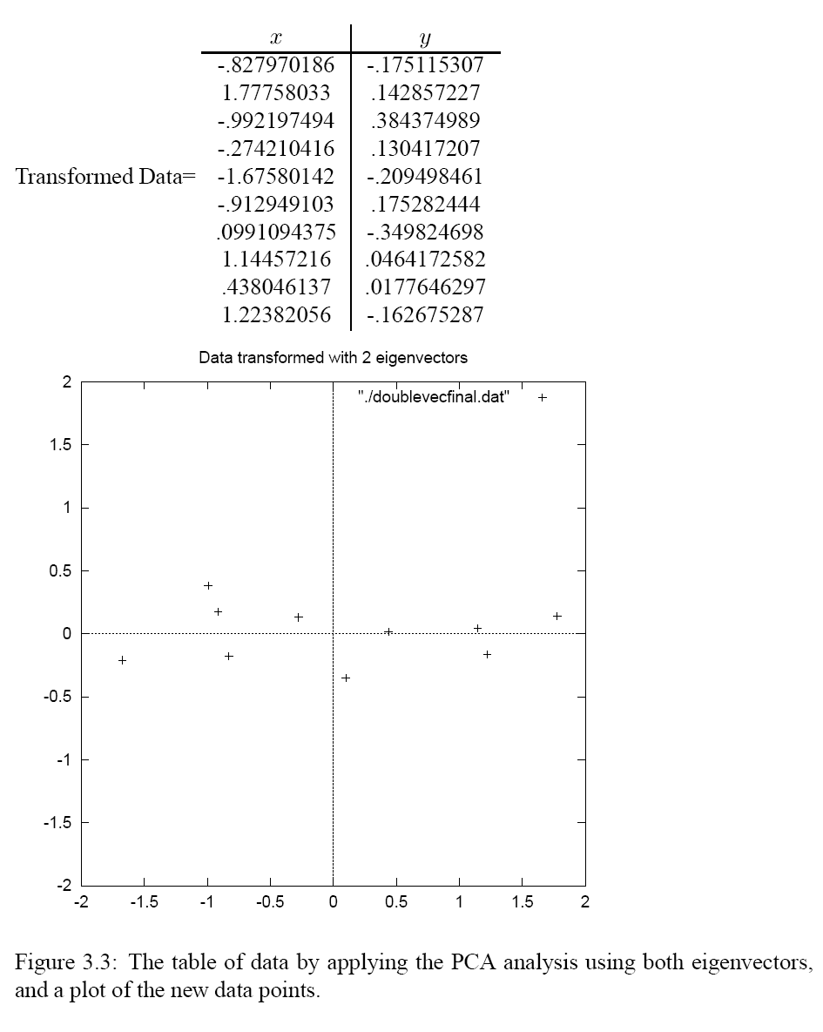
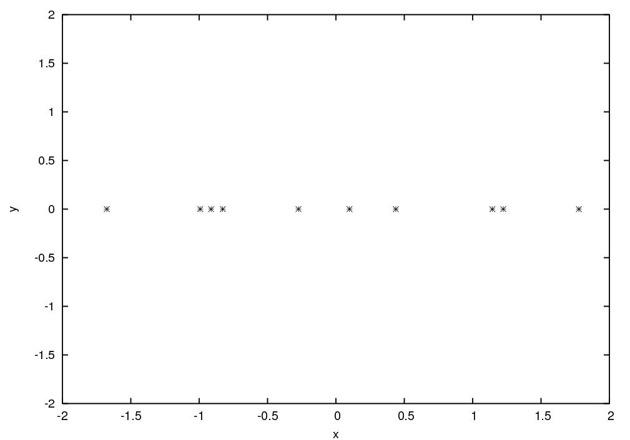
PCA process –STEP 5

Slide 17
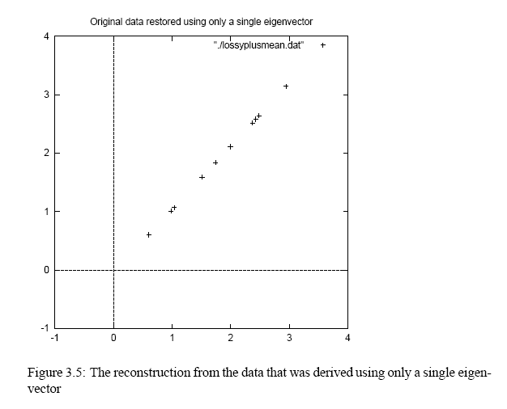
Reconstruction of original Data
x
-.827970186
1.77758033
-.992197494
-.274210416
-1.67580142
-.912949103
.0991094375
1.14457216
.438046137
1.22382056
If we reduced the dimensionality, obviously, when reconstructing the data we would lose those dimensions we chose to discard. In our example let us assume that we considered only the x dimension…

Slide 18
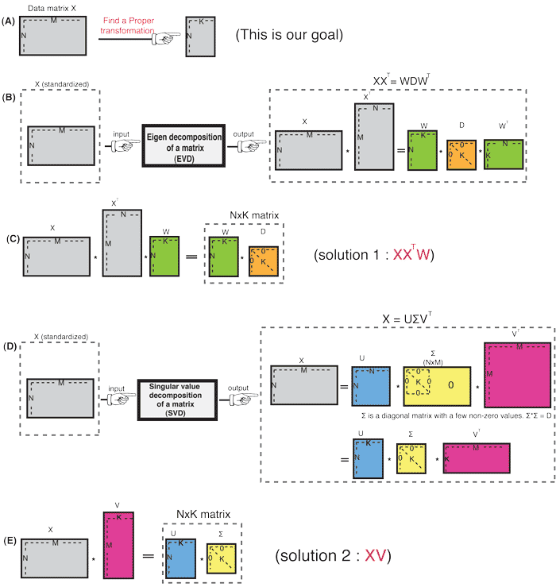
Eigen Value Decomposition
Singular Value Decomposition

Slide 19
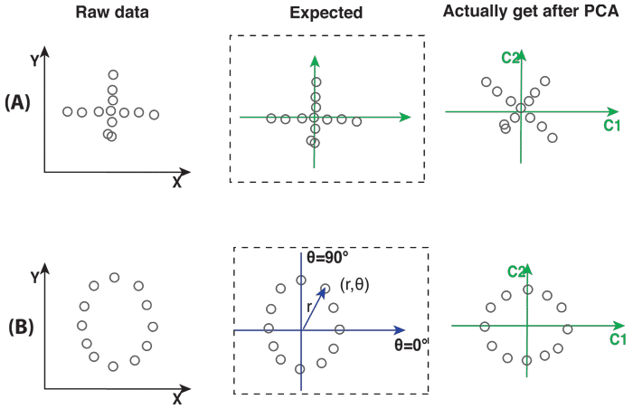
Limitations
Data does not follow a normal distribution
PCA also makes assumption that all principal components are orthogonal (linear uncorrelated) to each other. So it may fail when principal components are correlated in a non-linear manner. In such cases, before applying PCA, we need to first perform a non-linear transformation on raw data to create a new linear space in which variable θ becomes a linear dimension. And this method is called kernel-PCA.

Slide 20
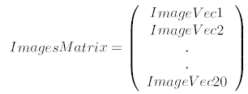
Application
Facial recognition
A square, N x N image can be expressed as N² dimensional vector
Say we have 20 images, we can then put all the images together in one big image-matrix like this:
We perform a PCA on the Image Matrix
Given a new image, whose face from the original set is it?
The way this is done is computer vision is to measure the difference between the new image and the original images, but not along the original axes, but along the new axes derived from the PCA analysis.
It turns out that these axes works much better for recognizing faces, because the PCA analysis has given us the original images in terms of the differences and similarities between them. The PCA analysis has identified the statistical patterns in the data.

Slide 21
Example: PCA for face recognition
Preprocessing: “Normalize” faces
Make images the same size
Line up with respect to eyes
Normalize intensities

Slide 22
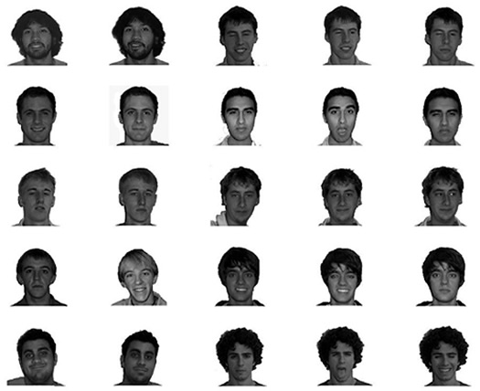

Slide 23
Raw features are pixel intensity values (2061 features)
Each image is encoded as a vector Γ_{i} of these features
Compute “mean” face in training set:

Slide 24
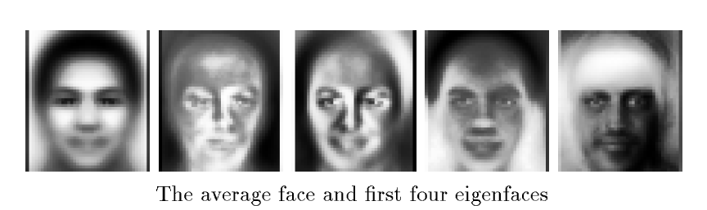
Subtract the mean face from each face vector
Compute the covariance matrix C
Compute the (unit) eigenvectors v_{i} of C
Keep only the first K principal components (eigenvectors)

Slide 25
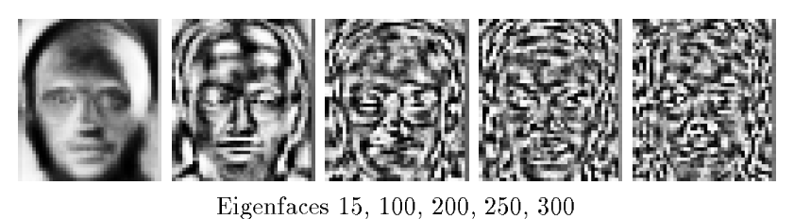
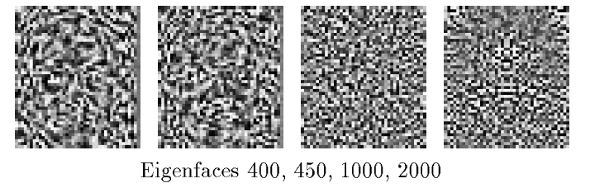

Slide 26
The eigenfaces encode the principal sources of variation
in the dataset (e.g., absence/presence of facial hair, skin tone,
glasses, etc.).
We can represent any face as a linear combination of these
“basis” faces.
Use this representation for:
Face recognition
(e.g., Euclidean distance from known faces)
Linear discrimination
(e.g., “glasses” versus “no glasses”,
or “male” versus “female”)

Slide 27

Principal Components Analysis: mathematical details
The first principal component of a set of features
X₁, X₂, . . . , X_{p} is the normalized linear combination of the features
Z₁ = φ₁₁X₁ + φ₂₁X₂ + . . . + φ_{p1}X_{p}
that has the largest variance. By normalized, we mean that
We refer to the elements φ₁₁, . . . , φ_{p1} as the loadings of the first principal component; together, the loadings make up the principal component loading vector,
φ₁ = (φ₁₁ φ₂₁ . . . φ_{p1})^{T} .
We constrain the loadings so that their sum of squares is equal to one, since otherwise setting these elements to be arbitrarily large in absolute value could result in an arbitrarily large variance.

Slide 28
PCA: example
Ad Spending
0 5 10 15 20 25 30 35
10
20
30 40 50
60
70
Population
The population size (pop) and ad spending (ad) for 100 different cities are shown as purple circles. The green solid line indicates the first principal component direction, and the blue dashed line indicates the second principal component direction.

Slide 29

Computation of Principal Components
Suppose we have a n× p data set X. Since we are only interested in variance, we assume that each of the variables in X has been centered to have mean zero (that is, the column means of X are zero).
We then look for the linear combination of the sample feature values of the form
z_{i1} = φ₁₁x_{i1} + φ₂₁x_{i2} + . . . + φ_{p1}x_{ip} (1)
for i = 1, . . . , n that has largest sample variance, subject to
the constraint that
Since each of the x_{ij} has mean zero, then so does z_{i1} (for
any values of φ_{j1}). Hence the sample variance of the z_{i1}
can be written as

Slide 30
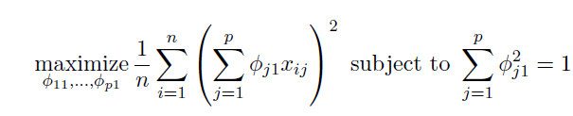
Computation: continued
Plugging in (1) the first principal component loading vector solves the optimization problem
This problem can be solved via a singular-value decomposition of the matrix X, a standard technique in linear algebra.
We refer to Z₁ as the first principal component, with realized values z₁₁, . . . , z_{n1}

Slide 31
Geometry of PCA
The loading vector φ₁ with elements φ₁₁, φ₂₁, . . . , φ_{p1} defines a direction in feature space along which the data vary the most.
If we project the n data points x₁, . . . , x_{n} onto this direction, the projected values are the principal component scores z₁₁, . . . , z_{n1} themselves.

Slide 32
Further principal components
The second principal component is the linear combination of X₁, . . . , X_{p} that has maximal variance among all linear combinations that are uncorrelated with Z₁.
The second principal component scores z₁₂, z₂₂, . . . , z_{n2}
take the form
z_{i2} = φ₁₂x_{i1} + φ₂₂x_{i2} + . . . + φ_{p2}x_{ip},
where φ₂ is the second principal component loading vector, with elements φ₁₂, φ₂₂, . . . , φ_{p2}.

Slide 33
Further principal components: continued
It turns out that constraining Z₂ to be uncorrelated with Z₁ is equivalent to constraining the direction φ₂ to be orthogonal (perpendicular) to the direction φ₁. And so on.
The principal component directions φ₁, φ₂, φ₃, . . . are the ordered sequence of right singular vectors of the matrix X, and the variances of the components are 1/n times the squares of the singular values. There are at most min(n − 1, p) principal components.

Slide 34
Illustration
USAarrests data: For each of the fifty states in the United States, the data set contains the number of arrests per
100, 000 residents for each of three crimes: Assault, Murder, and Rape. We also record UrbanPop (the percent of the population in each state living in urban areas).
The principal component score vectors have length n = 50, and the principal component loading vectors have length p = 4.
PCA was performed after standardizing each variable to have mean zero and standard deviation one.

Slide 35
USAarrests data: PCA plot
−0.5
0.0
0.5
3
UrbanPop
2
Hawaii
0.5
RhodMeaIslUsaatnacdhuseNttesw Jersey
California
Second Principal Component
1
Connecticut
Washington
Colorado
Ohio WiscoMnsininnesota Pennsylvania _{Oregon}
New York
Nevada
Illinois^{Arizona}
Texas
Rape
KansaOs klaho^{D}m^{el}a^{aware} Missouri
New Ha^{I}m^{ow}pªshire
Nebraska _{Indiana}
Michigan
0.0
0
Idaho
Virginia
New Mexico Maryland
Assault
TennesseLeouisiana
Florida
Maine
Wyoming
rth Dakota
Montana
−1
South Dakota
Kentucky
Arkansas
Alabama
Alaska Georgia
Murder
VermontWest Virginia
−0.5
−2
South Carolina
North Carolina Mississippi
−3
−3
−2
−1 0 1
First Principal Component
2
3

Slide 36
Figure details
The first two principal components for the USArrests data.
The blue state names represent the scores for the first two principal components.
The orange arrows indicate the first two principal component loading vectors (with axes on the top and right). For example, the loading for Rape on the first component is 0.54, and its loading on the second principal component 0.17 [the word Rape is centered at the point (0.54, 0.17)].
This figure is known as a biplot, because it displays both the principal component scores and the principal component loadings.

Slide 37
PCA loadings
 | PC1 | PC2
Murder | 0.5358995 | -0.4181809
Assault | 0.5831836 | -0.1879856
UrbanPop | 0.2781909 | 0.8728062
Rape | 0.5434321 | 0.1673186

Slide 38
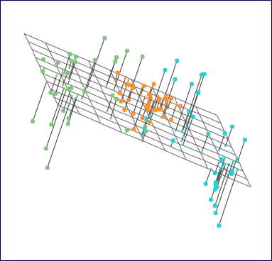
Another Interpretation of Principal Components
•
•
•
•
1.0
• • ••
• • •
•
• • • • • • • •
•
•
Second principal component
0.5
• •
• •
•
•
•
•
•
• •
•
0.0
• • ••
•
•
•••
•
•
•
• • • •
••• • • •
•
• •
•
• •
• •
•
−0.5
••
•
•
•
•
•• •••
•
•
• • •• •
−1.0
−1.0
−0.5
0.0 0.5
First principal component
1.0

Slide 39
PCA find the hyperplane closest to the observations
The first principal component loading vector has a very special property: it defines the line in p-dimensional space that is closest to the n observations (using average squared Euclidean distance as a measure of closeness)
The notion of principal components as the dimensions that are closest to the n observations extends beyond just the first principal component.
For instance, the first two principal components of a data set span the plane that is closest to the n observations, in terms of average squared Euclidean distance.

Slide 40
Scaling of the variables matters
If the variables are in different units, scaling each to have standard deviation equal to one is recommended.
If they are in the same units, you might or might not scale the variables.
 | Scaled |  |  | Unscaled
−0.5 | 0.0 | 0.5 | −0.5 | 0.0 | 0.5 | 1.0
3
 |  |  |  |  |  |  | ** ** | UrbanPop * * * * * R**ape * * * * | *
 |  |  |  |  |  | * | *
 |  |  |  | * | * |  | * *
 |  |  |  |  |  | * | * * *
* | * | * * |  | * * | * | * | * * * * | * A*ssault * * * * M*urder * ** |  | *
150
UrbanPop
1.0
Second Principal Component
2
0.5
Second Principal Component
−100 −50 0 50 100
0.5
1
0.0
*
Rape
*
0
* * * * **
** *
**
*
* *
** * * * * *
0.0
* * ** *
*M* urd*er * * *
* * Assa
* **
* * *
−2 −1
*
*
*
−0.5
−0.5
−3
−3 −2 −1 0
1
2
3
−100 −50 0 50 100 150
First Principal Component
First Principal Component

Slide 41



Proportion Variance Explained
To understand the strength of each component, we are interested in knowing the proportion of variance explained (PVE) by each one.
The total variance present in a data set (assuming that the variables have been centered to have mean zero) is defined as
and the variance explained by the mth principal component is
It can be shown that
with M = min(n − 1, p).

Slide 42

Proportion Variance Explained: continued
Therefore, the PVE of the mth principal component is given by the positive quantity between 0 and 1
The PVEs sum to one. We sometimes display the cumulative PVEs.
0.0 0.2 0.4 0.6 0.8 1.0
0.0 0.2 0.4 0.6 0.8 1.0
Cumulative Prop. Variance Explained
Prop. Variance Explained
1.0 1.5 2.0 2.5 3.0 3.5 4.0
1.0 1.5 2.0 2.5 3.0 3.5 4.0
Principal Component
Principal Component

Slide 43
How many principal components should we use?
If we use principal components as a summary of our data, how many components are sufficient?
No simple answer to this question, as cross-validation is not available for this purpose.
Why not?
When could we use cross-validation to select the number of components?
The “scree plot” on the previous slide can be used as a guide: we look for an “elbow”.

Slide 44
PCA in R
pr.out<-prcomp(USArrests, scale=TRUE)
names(pr.out)
pr.out$center
pr.out$scale
pr.out$rotation
dim(pr.out$x)
biplot(pr.out, scale=0)
pr.out$rotation=-pr.out$rotation
pr.out$x=-pr.out$x
biplot(pr.out, scale=0)
pr.out$sdev
pr.var=pr.out$sdev^2
pr.var
pve=pr.var/sum(pr.var)
pve
plot(pve, xlab="Principal Component", ylab="Proportion of Variance Explained", ylim=c(0,1),type='b')
plot(cumsum(pve), xlab="Principal Component", ylab="Cumulative Proportion of Variance Explained", ylim=c(0,1),type='b')

Slide 45
Practice / HW
Load the Cars93 dataset in the MASS package in R
Run a principal component analysis on columns 4 through 8 in the dataset
Plot the biplot
Calculate the percent of variance explained
Plot the percent of variance explained
How much of the variance does the first two principal components explain?

Slide 46
Readings
A tutorial on Principal Components Analysis by Lindsay I Smith. PDF on Blackboard
Chapter 10 pages 374 – 385, 401 - 404 in An Introduction to Statistical Learning by Gareth James et al.

